Slide 1
Raising Prices on Alcohol through
Exercise Taxes and Pricing policies
Team: Rogers Kasirye, Rogers Mutaawe, Anna Nabulya and Clare Nabulime
Uganda Youth Development Link (UYDEL)
E- mail kasiryer@yahoo.com
www.uydel.org

Slide 2
Outline
Taxation regime
Alcohol Map vs Harm issues
Observations
Discussion
Conclusion

Slide 3
Top contributors of Local Excise Duties collections

Slide 4
Top 10 contributors of VAT in FY 2019/2020
Source: URA Annual Performance Report 2019/2020

Slide 5
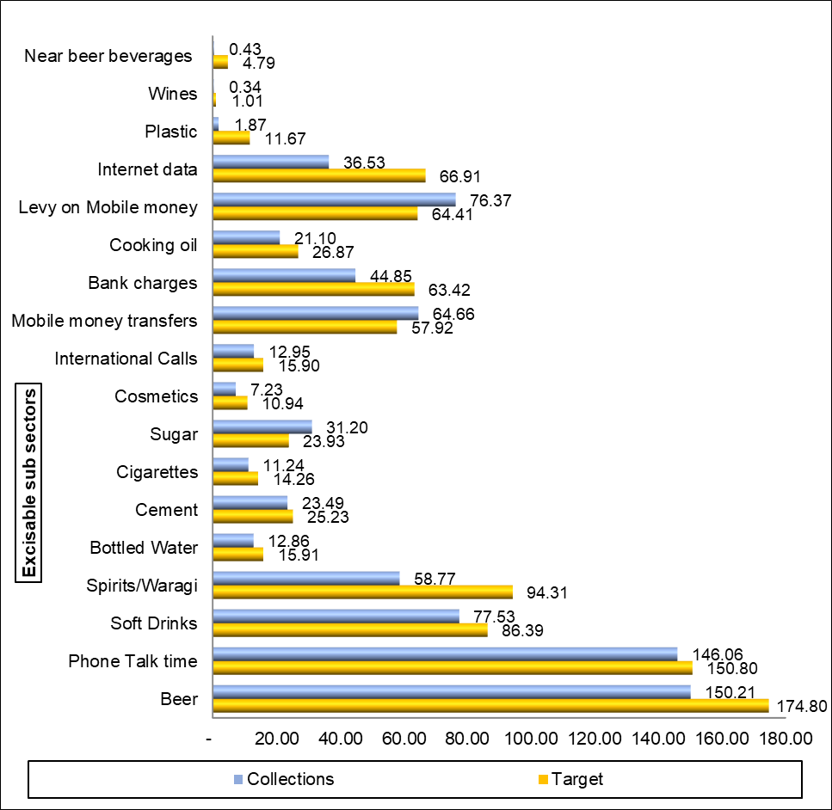
Local Excise Duty Performance for period July to December 2021
Source: Half Year Revenue Performance report July to December 2021

Slide 6
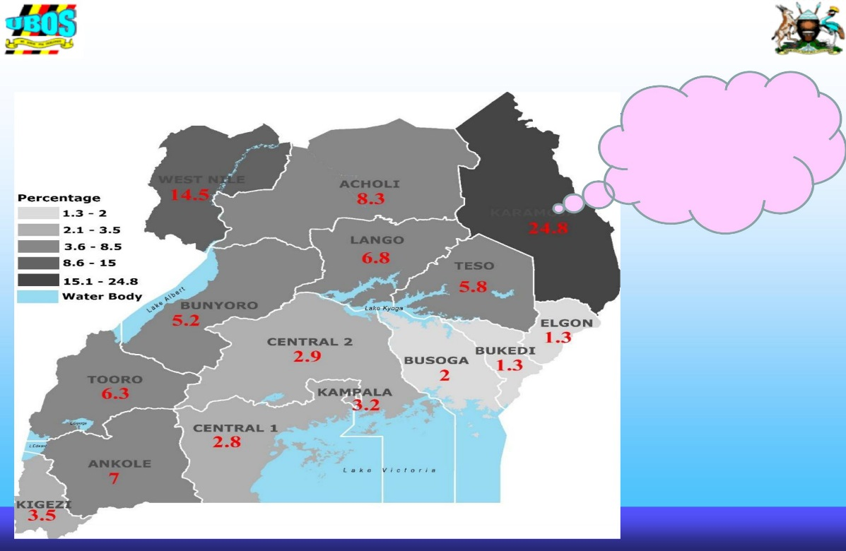
Poverty Vis Avis alcohol consumption and the Uganda Drinking Map.
Source: UBOS 2016/17

Slide 7
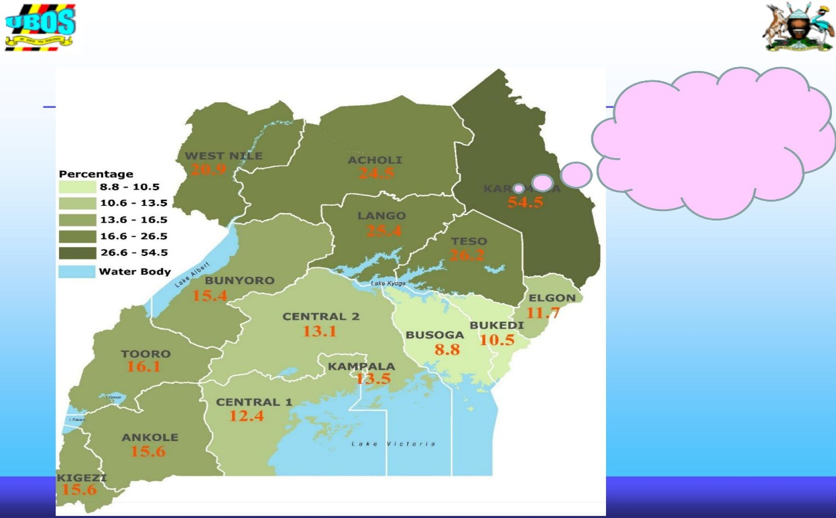
Vicious cycle of Poverty
Source: UBOS 2016/17

Slide 8
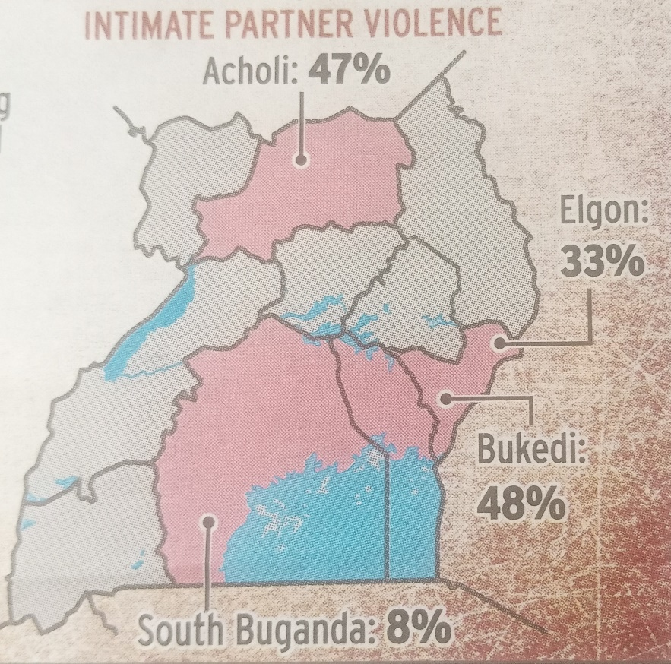
GENDER BASED VIOLENCE

Slide 9
Pattern and observations Taxation in Uganda 1
Alcohol industry contributes significantly to total national revenue collected per Tax category (appear in the top five tax contributors per tax type above.
A sign of increased alcohol consumption every year in Uganda.
Current alcohol consumption was high among the males at 17 percent compared to the females at seven percent (UBOS, 2019).
Alcohol revenue targets for Local Excise Tax collection are higher than other excisable products because they rely on its significant contribution to the tax revenue.

Slide 10
Pattern and observations Taxation in Uganda 2
URA introduced digital stamps and electronic fiscal devises for eight products (cigarettes, beers, sodas, water, wines, spirits, sugar and cement) which has expanded of tracing and tracking products which has grown the revenue contributions from the VAT and LED tax heads.
Efforts towards curbing illicit trade and eliminating uneven playfields for taxpayers.

Slide 11
Loss of revenue Vs Revenue growth
Price of alcohol still at the same price: as Early as the financial year 2018\19 Uganda government amended the Tax Act and section 21(1) was introduced providing for corporate income tax exemptions for firms, which operate in priority sectors, and meet a qualifying investment threshold;
Those sourcing 70% raw materials and those who accounting for at least 70% of Ugandan citizen.
A lot of revenue is lost in revenue exemption.
Government to deal away with alcohol harm arising out of alcohol.

Slide 12
Re-aligning Alcohol Taxation Regime in Uganda Vs East Africa
Excise taxes on alcohol in Kenya are too high by a wide margin as compared to other East African countries and are being updated and enforced.
Excise tax rate in Uganda and Tanzania are too low to counterbalance the estimated net costs of misuse (Parry, 2003).
Rwanda collects 16% out of 8.376 billion dollars and Tanzania collects 47.43 billion USD In Kenya 20% out of 70,529 billion dollars.
Uganda collects 13% out of 25.53 billion USD far lower than most sub-Saharan African countries (Therefore a lot of revenue is lost as a result of low percentage of taxes.
There is need to investigate why Uganda pays lower taxes?

Slide 13
Re-aligning Alcohol Taxation Regime in Uganda Vs East Africa
There is need to align the tax regime to other East African countries. Kenya and Rwanda have less problems related to alcohol compared to Uganda).
Uganda alcohol consumption is still high but the revenue is not commensurate with the levels of consumptions and a lot of illicit alcohol still produced but untaxed (Swahn et al., 2018)
This local brew needs to be brought into the tax curve and increase its revenue. Untaxed illicit brew and many producers are outside the tax base.
Likewise, 56% of the population does not drink. Many young people may be living alcohol free.
Economic versus health benefits.

Slide 14
Taxes on alcohol but a shocking advert
During the 2019/2020 the budget increased taxes on alcohol but a shocking advert in one of the leading newspapers said that that the price of alcohol was still at the same price (taxation of alcohol is yet to be felt and bring the net results to increase revenue).
With the new Financial Year 2022/2023 factories producing the low-cost opaque beer will enjoy a tax relief intended to attract more local manufacturers into the alcohol production industry.
The proposal to reduce the excise duty rate on opaque beer would encourage the reopening of companies that had closed as a consequence of the higher tax as manufacturers of opaque beer will pay only 12 per cent or Shs150 per litre of the beer produced as compared to the current 20 per cent or Shs230 per litre. (Parliament of Uganda report 18th May 2022).
Government completely should eliminate these exemptions to the alcohol industry given the Alcohol burden created by alcohol and Mixture/hybrid of taxations

Slide 15
Immediate Measures
Tax alcohol inside the bottle (content) more tax (lethal and high addictive.
Limited impact of taxation may need serious review from time .
Packaging
Declare a total ban/eliminate alcohol in small bottles.
Only permit plastic bottles with a minimum of 250 mils.
Provide the national standards governing packaging drinks.
c) Ban the display and free distribution
Of alcohol and related products at public and social events.
Use of children in all trade activities related to alcohol.
d) Alcohol coordination body

Slide 16
Action points
Increase number of people who don’t drink from 56%. Reduce those who drink and stand at 36% (Mbona etal, 2022).
Abstinence
Raise drinking age to 21 years
Review the tax regime and alcohol and advertising
Declaration of such production and process of harmful products be included and discussed regularly to see how to expand the taxes
Eliminate such products irrespective of consumption area and their process (production for market or for consumption.

Slide 17
Harnessing the full potential of alcohol taxation, Potential and Window of Opportunity
Increase tax on alcohol, Deal away with alcohol tax exemptions
Deal with conflict of interests.
Deal with unethical alcohol marketing, packaging and selling points.
Enforce alcohol breathalysers
Economic costs of Alcohol harm is real and must be addresses
Untapped potential of alcohol taxation for investment in health and development.
Alcohol poisoning of interest in enforcement.

Slide 18
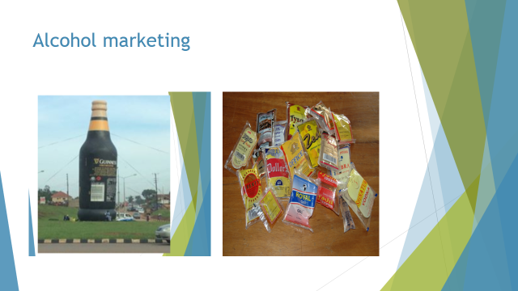

Slide 19
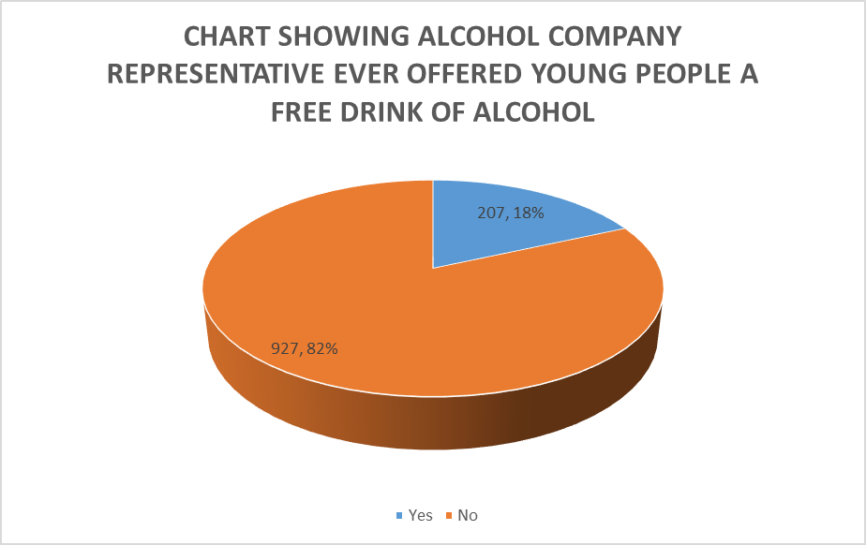
Swahn et al, 2017

Slide 20
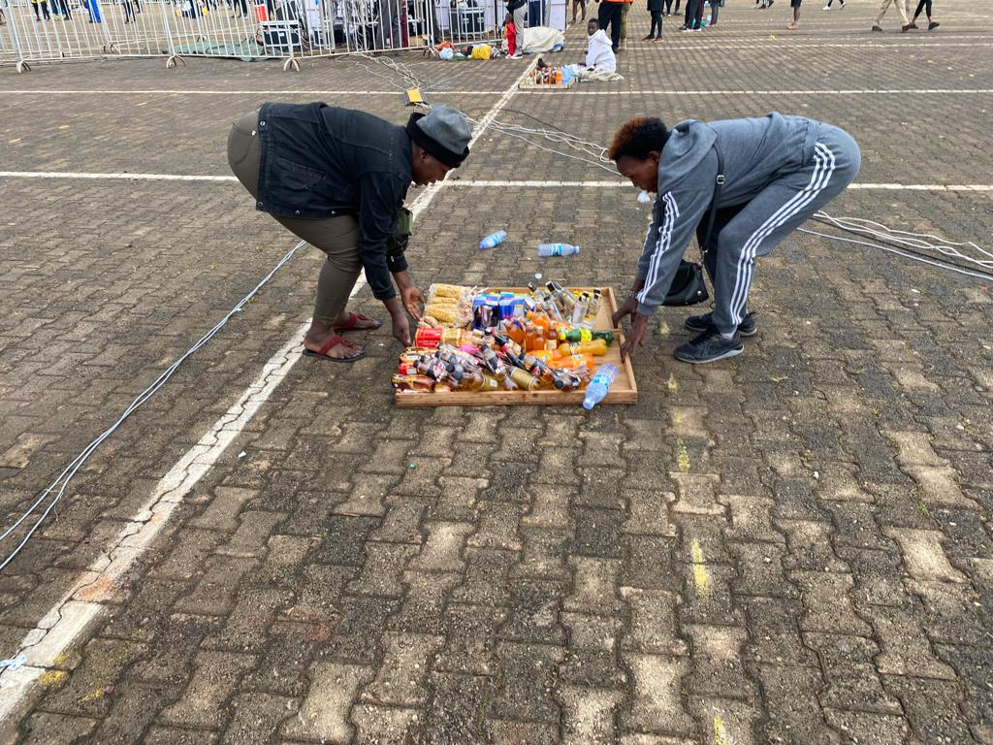
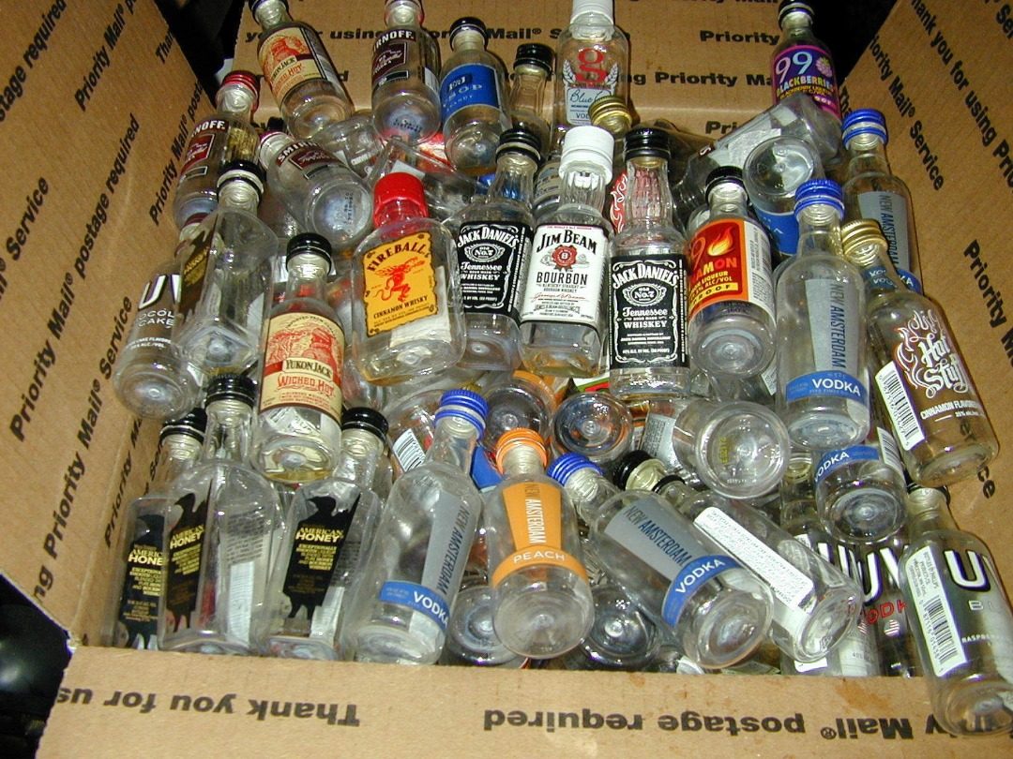
Tax alcohol inside the bottle

Slide 21
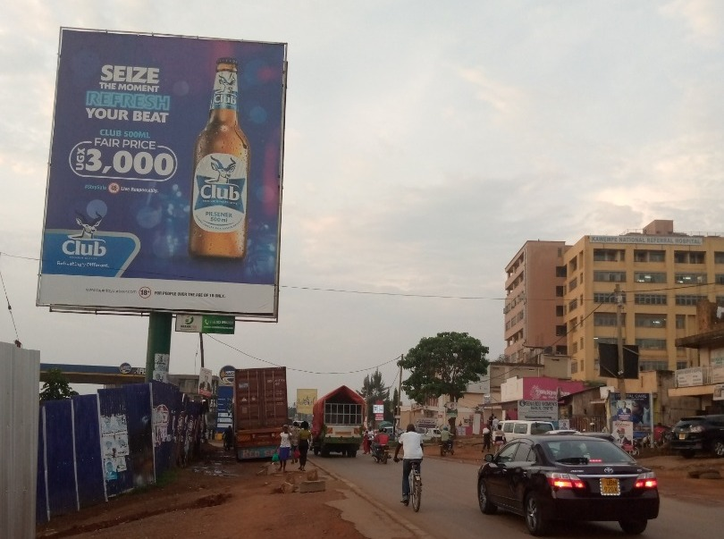

Slide 22
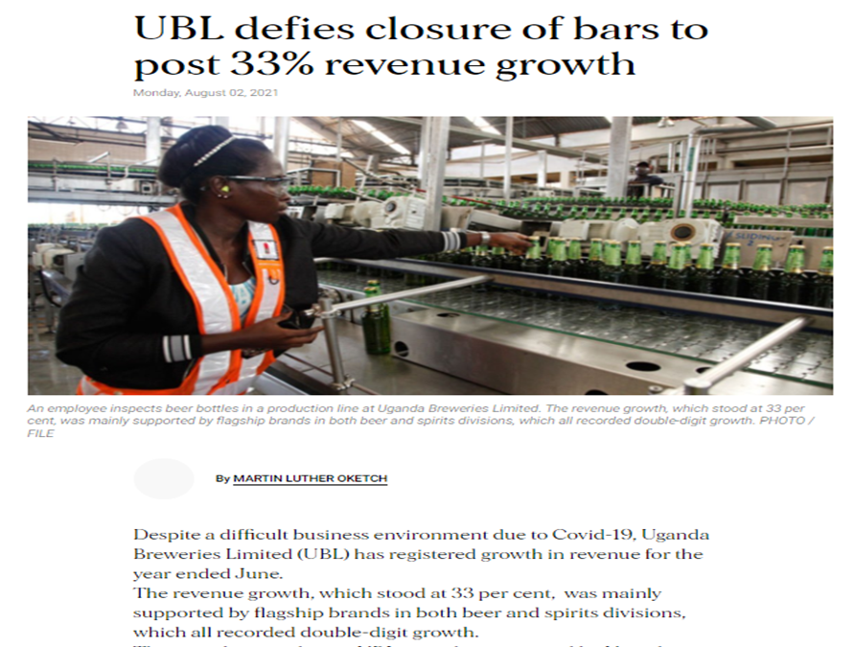

Slide 23
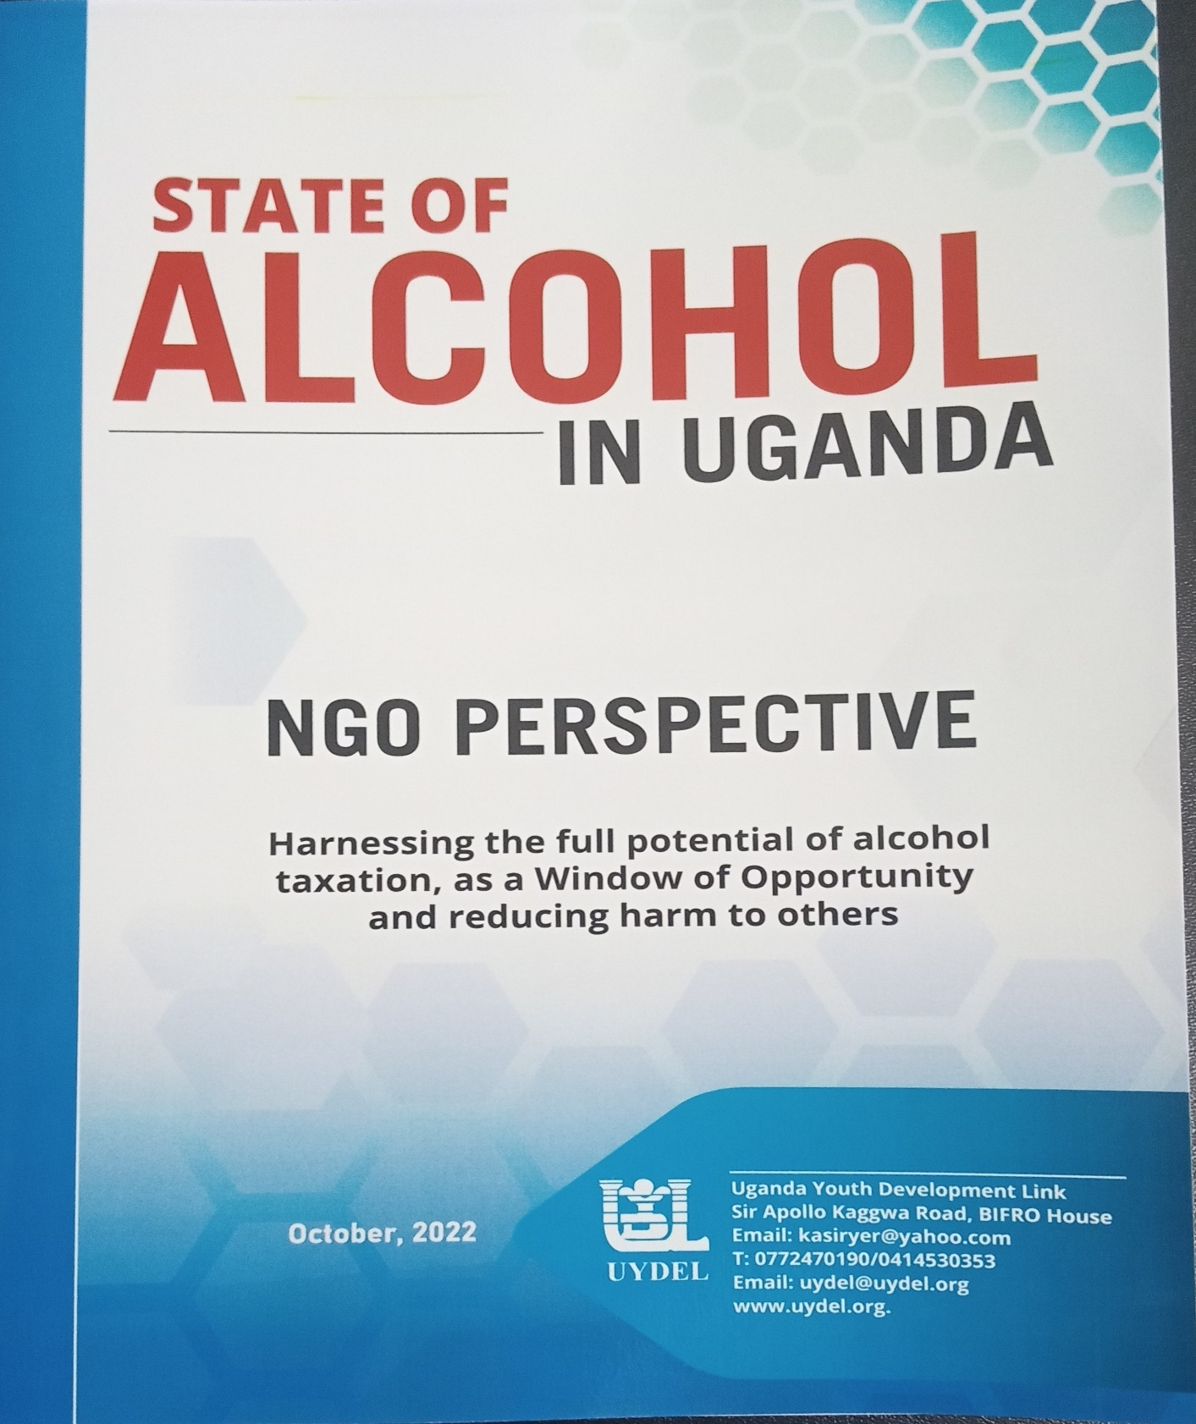

Slide 24
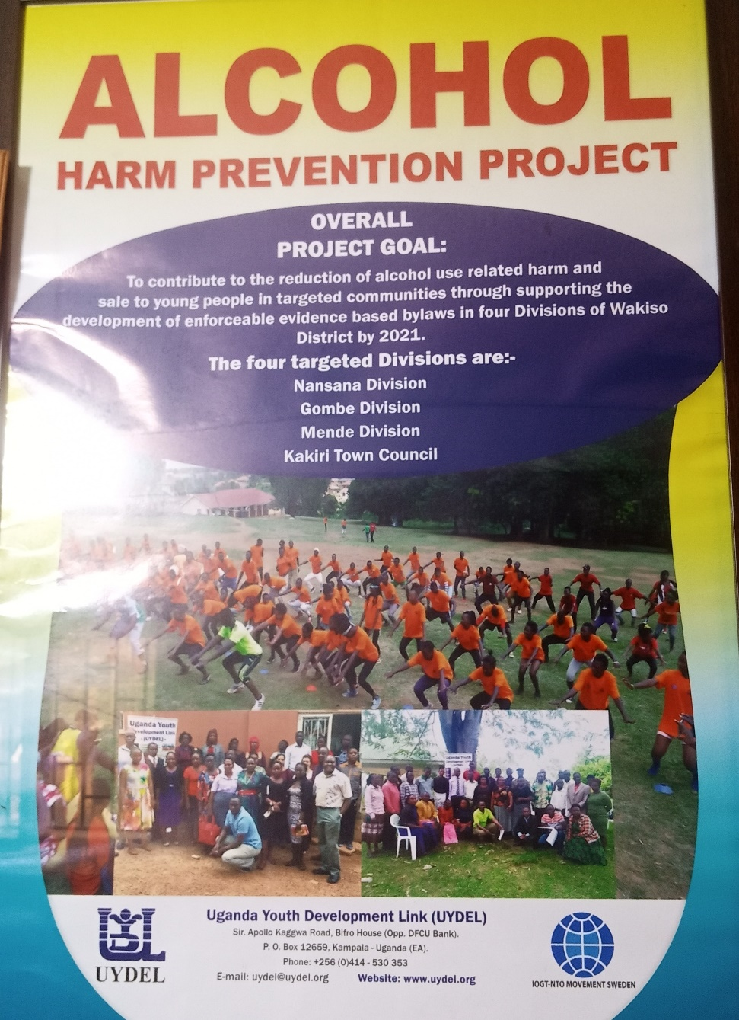

Slide 25
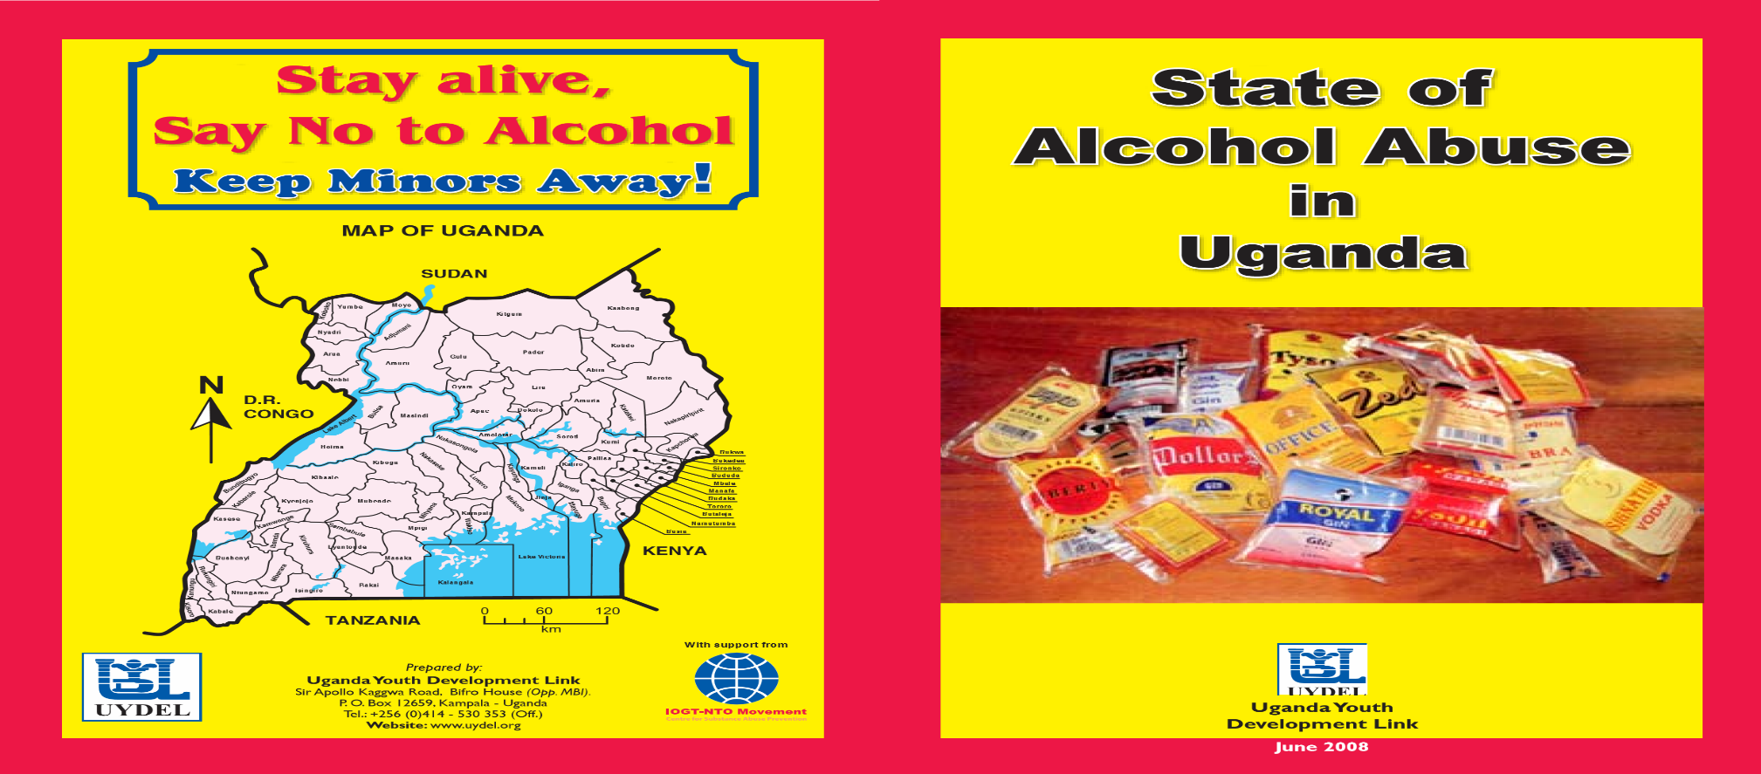

Slide 26


Slide 27
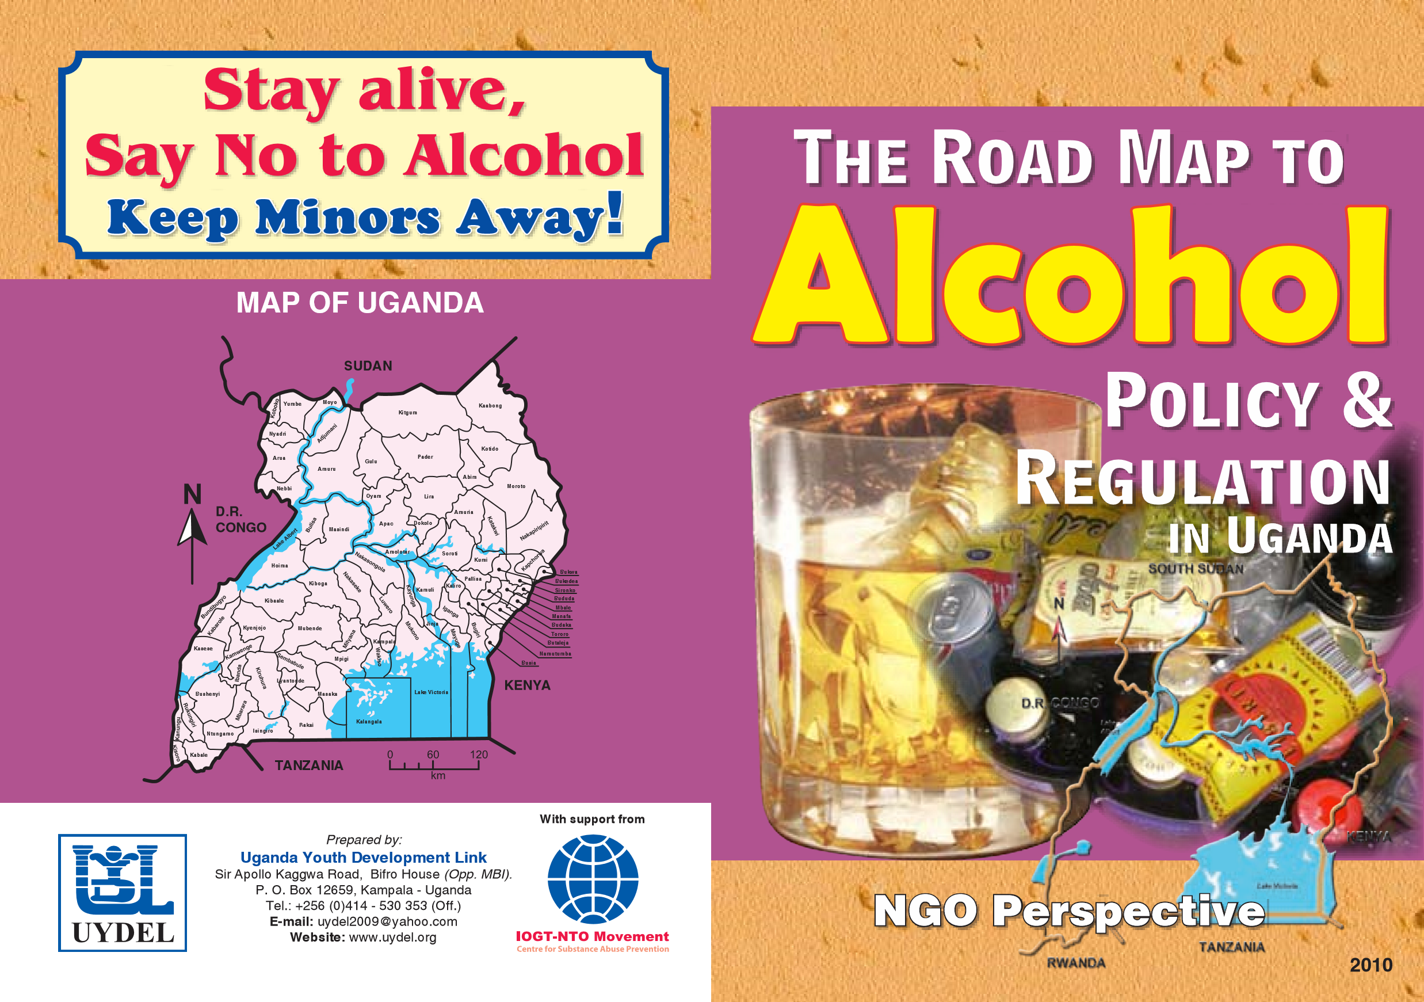

Slide 28


Slide 29

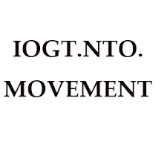
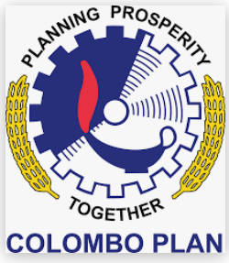





Thank You
Special Thanks goes Monica Swahn, Dr Basangwa
and Dr Kigozi(RIP)

